Slide 1
Structural link
Case 1
Link 1 → ( each, each)
Link 2 → ( each, each)
Shared Services Center | Global Integration & eServices

Slide 2
Structural link
1
Source
Destination
Header
2
Record
Line
3
4
Tail
Shared Services Center | Global Integration & eServices

Slide 3
Structural link
Incoming file
H:11111:
L:Hammer:11.00:
L:Saw:22.00:
T:2:33.00:
H:22222:
L:Piano:111.00:
L:Violin:222.00:
L:Kazoo:333.00:
T:3:666.00:
Outgoing file
L:Hammer:11.00:
L:Saw:22.00:
L:Piano:111.00:
L:Violin:222.00:
L:Kazoo:333.00:
Why we can get the expected result?
How do the links work?
Shared Services Center | Global Integration & eServices

Slide 4
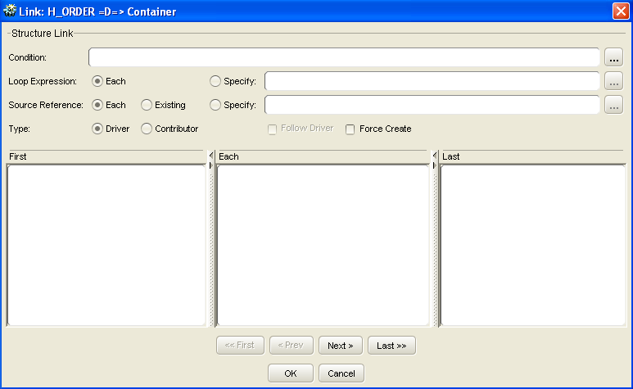
Structural link
Source record → Destination record
H_ORDER →Container
    If/When…
    How many loops
    From which occurrence
Default value:
Each
Each
Create same occurrence as H_ORDER
Choose H_ORDER from 1st to Loop Expression
Shared Services Center | Global Integration & eServices

Slide 5
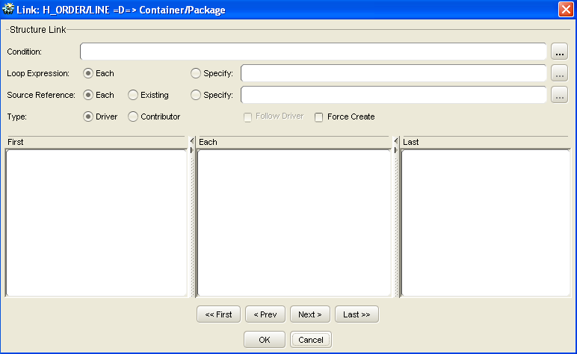
Structural link
Source record → Destination record
LINE → Package
Default value:
Each
Each
Shared Services Center | Global Integration & eServices

Slide 6
Structural link
    loop expression
    How many times the link shall execute
      Each
      The loop will execute one time for every occurrence of the source container.
    source reference
      Which occurrence of the source container to use for each loop of the link
        Each
        The occurrences of the source container will be used one by one starting
        with the first and then shifted to the next every time the loop executes,
        that is, 1, 2, 3,…, ‘Loop Expression’.
Shared Services Center | Global Integration & eServices

Slide 7
Structural link
Case2
Link 1 → ( 1, each)
Link 2 → ( each, each)
Shared Services Center | Global Integration & eServices

Slide 8
Structural link
1
Source
Destination
Header
2
Record
Line
3
4
Tail
Shared Services Center | Global Integration & eServices

Slide 9
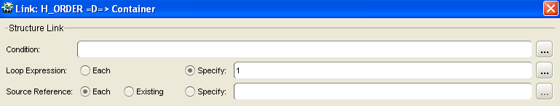
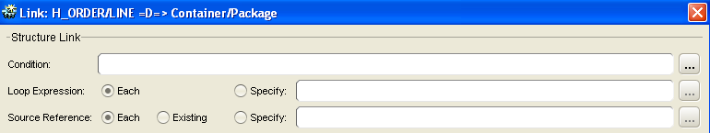
Structural link
H_ORDER →Container
“1” Container will be created
Choose H_ORDER from “1” to “Loop Expression”
LINE →Package
Same occurrence as LINE will be created
Choose LINE from “1” to “Loop Expression”
Shared Services Center | Global Integration & eServices

Slide 10
Structural link
Case 3
Link 1 → ( each, 1)
Link 2 → ( each, each)
Shared Services Center | Global Integration & eServices

Slide 11
Structural link
1
Source
Destination
Header
2
Record
Line
3
4
Tail
Shared Services Center | Global Integration & eServices

Slide 12
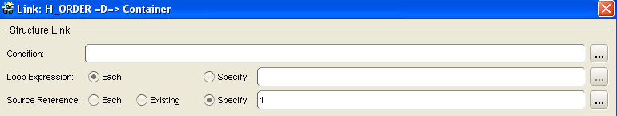
Structural link
H_ORDER →Container
Same occurrence as H_ORDER will be created
1st H_ORDER will be chosen
LINE →Package
Same occurrence as LINE will be created
Choose LINE from “1” to “Loop Expression”
Shared Services Center | Global Integration & eServices

Slide 13
Structural link
Case 4
Link 1 → ( each, each)
Link 2 → ( 1, each)
Shared Services Center | Global Integration & eServices

Slide 14
Structural link
1
Source
Destination
Header
2
Record
Line
3
4
Tail
Shared Services Center | Global Integration & eServices

Slide 15
Structural link
H_ORDER →Container
Same occurrence as H_ORDER will be created
Choose H_ORDER from 1st to “Loop Expression”
LINE →Package
“1” Package will be created
Choose LINE from 1st to “Loop Expression”
Shared Services Center | Global Integration & eServices

Slide 16
Structural link
Case 5
Link 1 → ( each, each)
Link 2 → ( each, 1)
Shared Services Center | Global Integration & eServices

Slide 17
Structural link
1
Source
Destination
Header
2
Record
Line
3
4
Tail
Shared Services Center | Global Integration & eServices

Slide 18
Structural link
H_ORDER →Container
Same occurrence as H_ORDER will be created
Choose H_ORDER from 1st to “Loop Expression”
LINE →Package
Same occurrence as LINE will be created
1st LINE will be chosen
Shared Services Center | Global Integration & eServices

Slide 19
Structural link
Case 6
Link 1 → ( each, each)
Link 2 → ( 1, 2)
Shared Services Center | Global Integration & eServices

Slide 20
Structural link
H_ORDER →Container
Same occurrence as H_ORDER will be created
Choose H_ORDER from 1st to “Loop Expression”
LINE →Package
Package will be created 1 time
2nd LINE will be chosen
Shared Services Center | Global Integration & eServices

Slide 21
Structural link
Case 7
Link 1 → ( each, each)
Link 2 → ( 2, 1)
Shared Services Center | Global Integration & eServices

Slide 22
Structural link
1
Source
Destination
Header
2
Record
Line
3
4
Tail
Shared Services Center | Global Integration & eServices

Slide 23
Structural link
H_ORDER →Container
Same occurrence as H_ORDER will be created
Choose H_ORDER from 1st to “Loop Expression”
LINE →Package
Package will be looped 2 times
1st LINE will be chosen
Shared Services Center | Global Integration & eServices

Slide 24
Structural link
Case 8: ( 1, existing)
Shared Services Center | Global Integration & eServices

Slide 25
Structural link
1
H_ORDER
Container
Header
2
Pallet
Line
Package
Tail
Shared Services Center | Global Integration & eServices

Slide 26
Structural link
Incoming file
Outgoing file
H:11111:
L:Hammer:11.00:
L:Saw:22.00:
T:2:33.00:
H:22222:
L:Piano:111.00:
L:Violin:222.00:
L:Kazoo:333.00:
T:3:666.00:
L:Hammer:11.00:
L:Saw:22.00:
L:Piano:111.00:
L:Violin:222.00:
L:Kazoo:333.00:
same request
Different structure in destination
Shared Services Center | Global Integration & eServices

Slide 27
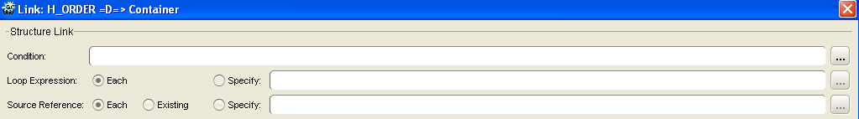
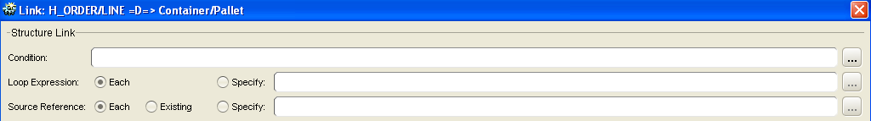
Structural link
H_ORDER →Container
Same occurrence as H_ORDER will be created
Choose H_ORDER from 1st to “Loop Expression”
LINE →Pallet
Same occurrence as LINE will be created
Choose H_ORDER from 1st to “Loop Expression”
LINE →Package
Same occurrence as LINE will be created
Choose H_ORDER from 1st to “Loop Expression”
Shared Services Center | Global Integration & eServices

Slide 28
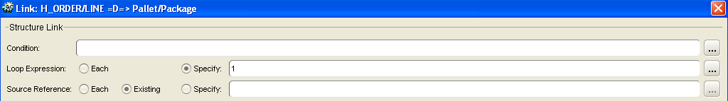
Structural link
H_ORDER →Container
Same occurrence as H_ORDER will be created
Choose H_ORDER from 1st to “Loop Expression”
LINE →Pallet
Same occurrence as LINE will be created
Choose H_ORDER from 1st to “Loop Expression”
LINE →Package
Package will created 1 time
Choose the existing source record
Shared Services Center | Global Integration & eServices

Slide 29
Structural link
    loop expression
    How many times the link shall execute
      Specify: 1
    source reference
      Which occurrence of the source container
      to use for each loop of the link
      Existing
        If the reference for this source container has already been
        specified in a previous link, selecting Existing means that this
        link will not change the source reference.
Shared Services Center | Global Integration & eServices

Slide 30
Structural link
What did we cover?
Shared Services Center | Global Integration & eServices

Slide 31
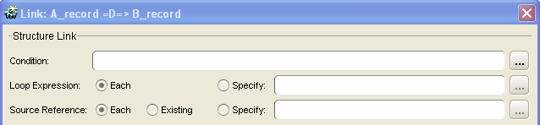
Structural link
GUI Dialog:
    Condition
    Loop Expression
      Each
      Specify
    Source Reference
      Each
      Existing
      Specify
What to read:
    If/When…
    How many loops…
      For each input
      Fixed/Variable No.
    From which occurrence
      Loop over all source rec.
      Use existing reference
      Fixed/variable no.
Shared Services Center | Global Integration & eServices

Slide 32
Structural link
Homework
Shared Services Center | Global Integration & eServices

Slide 33
Structural link
    1. Review Defining links
    2. Main code
    3. Prepare for driver link and contributor link
Shared Services Center | Global Integration & eServices

